Slide 1
CENG 538 Advanced Graphics and UIs
Texture Mapping

Slide 2
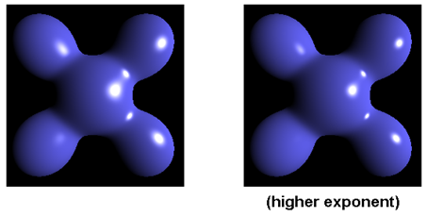
Until Now
We assumed that object have fixed R, G, B reflectance values.
Surface orientation and light direction determined the shading of objects.
Our best image so far is something like:

Slide 3
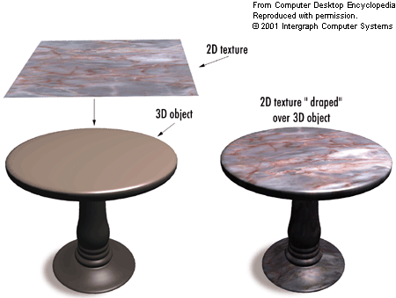
Texture Mapping
Goal: Increase visual realism by using images to simulate reflectance characteristics of objects.
A cheap and effective way to spatially vary surface reflectance.
From http://img.tfd.com

Slide 4
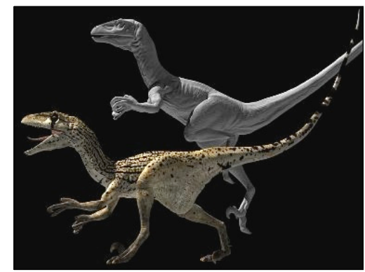
Texture Mapping
Goal: Increase visual realism by using images to simulate reflectance characteristics of objects.
A cheap and effective way to spatially vary surface reflectance.
Which one more realistic?

Slide 5
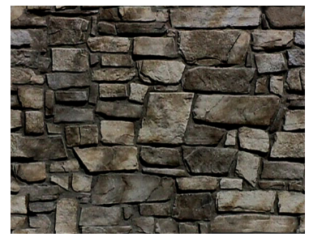
Texture Mapping
Motivation: Need millions of polygons to model this:
Difficult and cumbersome ☹

Slide 6
Texture Mapping
Motivation: Render a simple polygon with this picture:
Easy and cool ☺

Slide 7
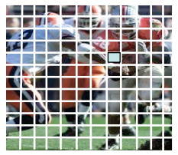
Terminology
Texture: An array of values
2D (most common), 1D, 3D
Color, alpha, depth, normal
Texel: A single array element
Texture mapping: The process of relating texture to geometry

Slide 8
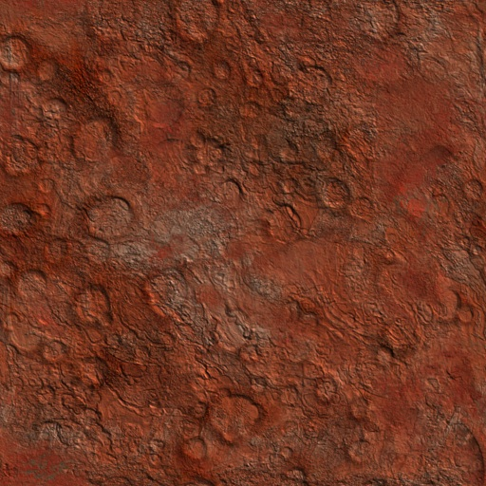
Roadmap
Step 1: Associate an (u, v) coordinate system with the texture image where (u, v) ∈ [0,1]x[0,1]
v
u

Slide 9
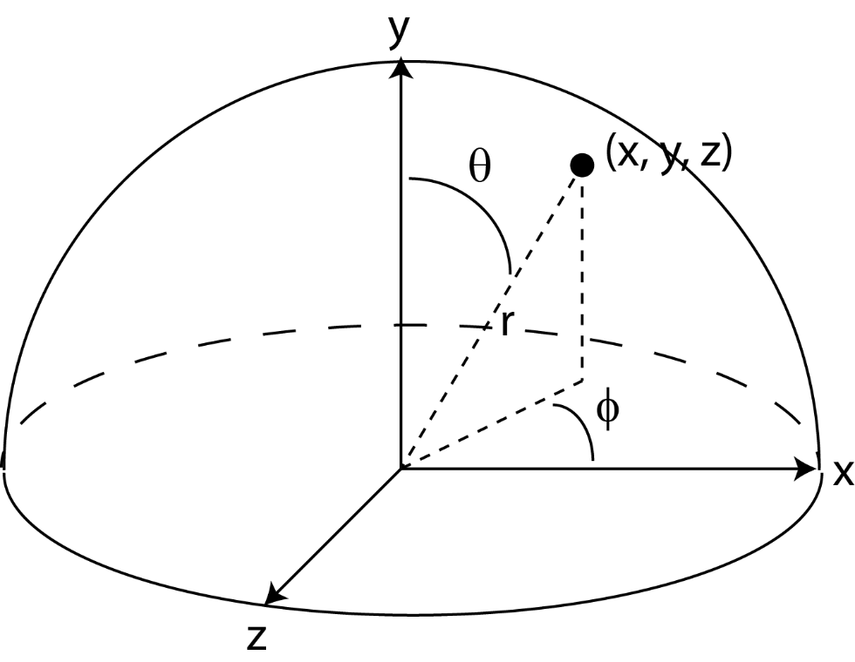
Roadmap
Step 2: Parameterize the surface to be texture mapped using two coordinates. For instance, a sphere:
Assuming that the center is at (0, 0, 0):
x = rsinΘcosϕ
y = rcosΘ
z = rsinΘsinϕ
Θ = arccos(y / r)
ϕ = arctan(z / x)
(Θ, ϕ) ∈ [0,π]x[0,2π]

Slide 10
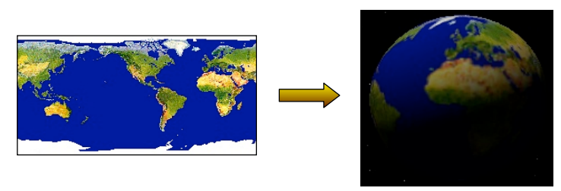
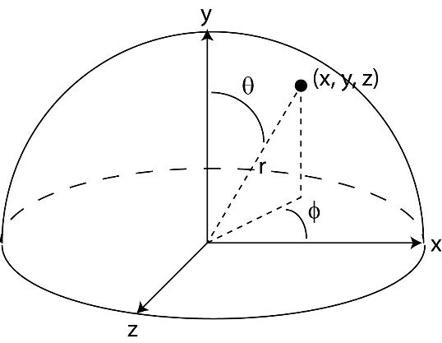
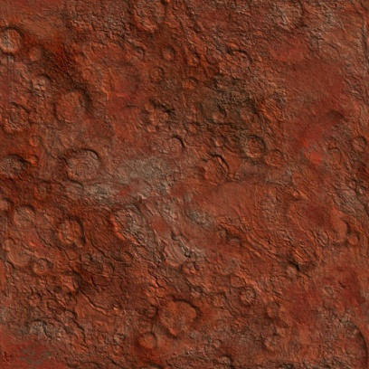
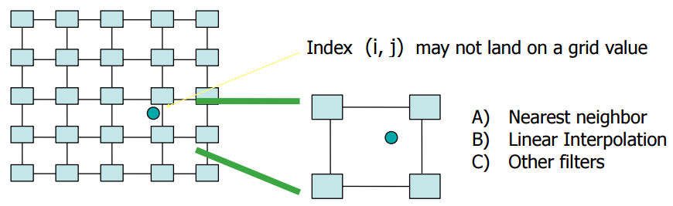
Roadmap
Step 3: Compute a (u, v) value for every surface point. For instance, a sphere:
Step 4: Find the texture image coordinate (i, j) at the given (u, v) coordinate:
u = ϕ / (2π)
v = (π – Θ) / π = 1 – Θ/ π
i = u.n_{x}
Note that i, j can be fractional!
j = v.n_{y}
n_{x} = texture image width
n_{y} = texture image height

Slide 11
Roadmap
Step 5: Choose the texel color using a suitable interpolation strategy.
Nearest Neighbor: fetch texel at nearest coordinate
Color(x, y, z) = fetch(round(i, j))
Bilinear Interpolation: Average four closest neighbors:
Color(x, y, z) = fetch(round(i, j)).(1 – a).(1 – b) +
fetch(round(i+1, j)).(a).(1 – b) +
fetch(round(i, j+1)).(1 – a).(b) +
fetch(round(i+1, j+1)).(a).(b)
(i,j)
b
a

Slide 12
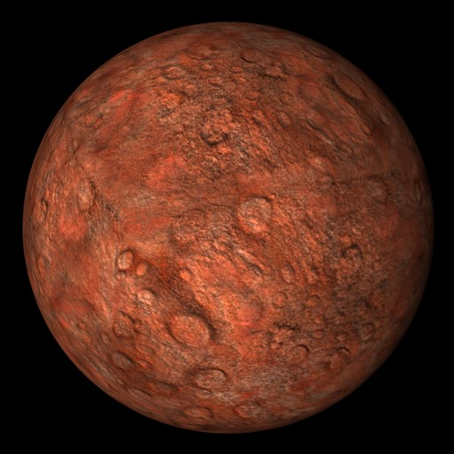
Result

Slide 13
An Interesting Usage

Slide 14
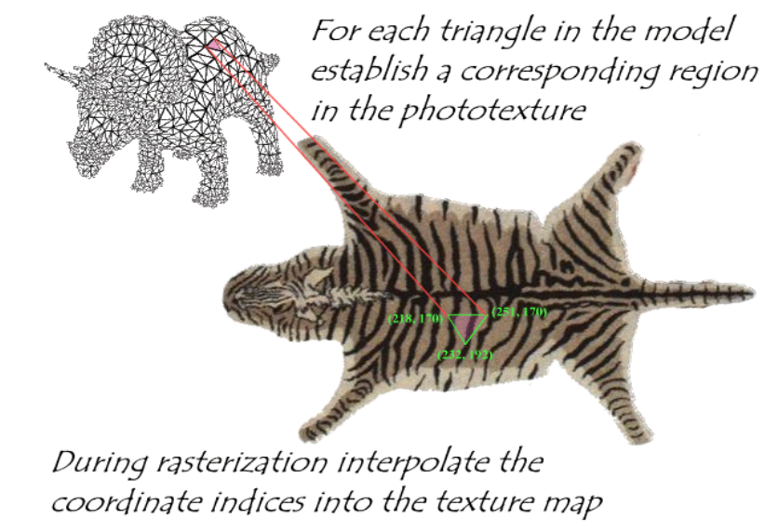
Mapping an Arbitrary Object
Need a mapping b/w the texture and object (‘s triangles)

Slide 15
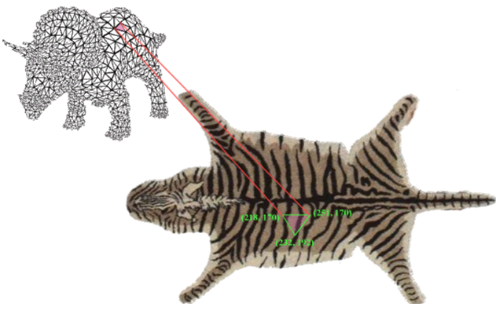
Mapping an Arbitrary Object
Need a mapping b/w the texture and object (‘s triangles)
Problems
A 3D point on the surface maps to a location b/w texels in the texture
Handle this by Step 5 (NN or Interpolation)
Only 3 vertices of surface triangle are known; others’ colors?
Any 3D point in the triangle can be represented by barycentric coordinates (interpolation)
Apply the corresponding barycentric coordinates to the texture
Again use Step 5 to get the integer texture coordinates
Detailed in the next slide

Slide 16
Mapping an Arbitrary Object
First, we must associate (u, v) coordinates for each vertex
The (u, v) coordinates inside the triangle can be found using the barycentric coordinates
Recall that the position of point p at barycentric coordinates (β, γ) is equal to:
p(β, γ) = a + β(b – a) + γ(c – a)
Texture coordinates can be interpolated similarly:
u(β, γ) = u_{a} + β(u_{b} – u_{a}) + γ(u_{c} – u_{a})
v(β, γ) = v_{a} + β(v_{b} – v_{a}) + γ(v_{c} – v_{a})

Slide 17
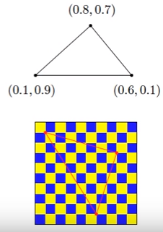
Mapping an Arbitrary Object
p(β, γ) = a + β(b – a) + γ(c – a)
u(β, γ) = u_{a} + β(u_{b} – u_{a}) + γ(u_{c} – u_{a})
v(β, γ) = v_{a} + β(v_{b} – v_{a}) + γ(v_{c} – v_{a})
β
γ
β
γ

Slide 18
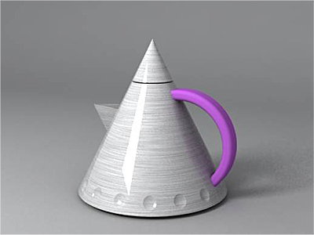
Texture Mapping and Shading
Note that texture mapping and shading are not mutually exclusive.
Just get the base color in our shading model from the texels
Ir = Cr*(AMBr + DIFr * n.l) + CLr * SPEr * (n.h)^{p}
Ig = Cg*(AMBg + DIFg * n.l) + CLg * SPEg * (n.h)^{p}
Ib = Cb*(AMBb + DIFb * n.l) + CLb * SPEb * (n.h)^{p}
From http://www.vray.com

Slide 19
Texture Mapping Approaches
Intermediate Mapping
Map the texture onto a simple intermediate surface
Map the intermediate surface to the final object
Intermediate objects
Plane
Sphere
Cylinder
Cube

Slide 20
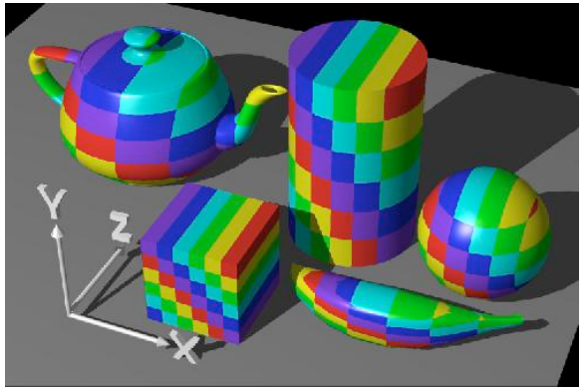
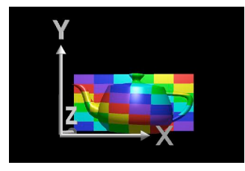
Planar Mapping
Project to an axis-aligned plane
Drop the z coordinate if using the xy-plane: (i, j) = (x, y)

Slide 21
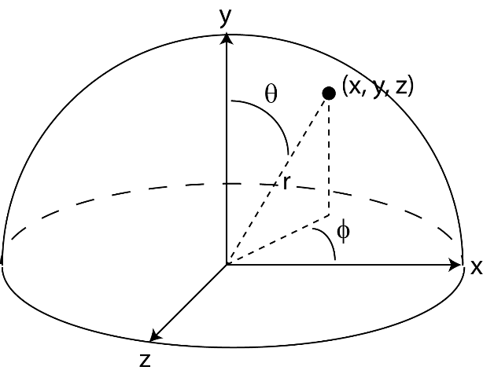
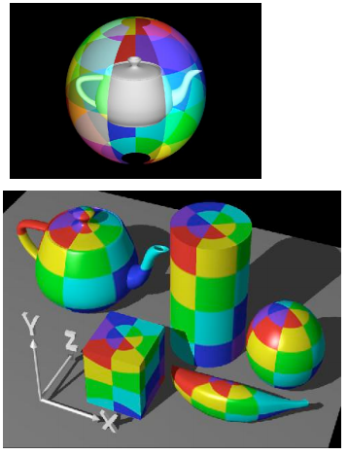
Spherical Mapping
Already seen this in Slide 9
Convert (x, y, z) into spherical coordinates (Θ, ϕ)

Slide 22
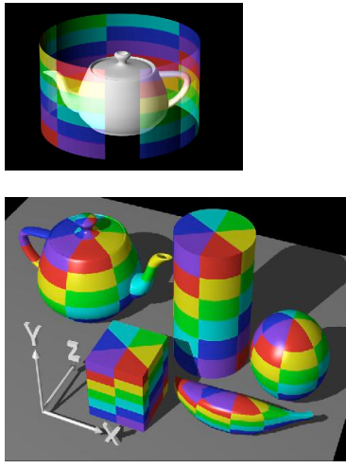
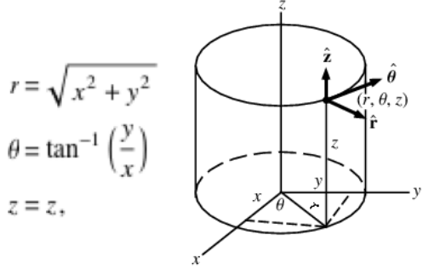
Cylindrical Mapping
Convert (x, y, z) into cylindrical coordinates (r, Θ, z)
Use (i, j) = (Θ, z) as the texture coords

Slide 23
Texture Generation
Acquiring a 2D texture
Scanned photo
Artistic drawing
Space filling X
Stripes
Checkerboard
Rings

Slide 24
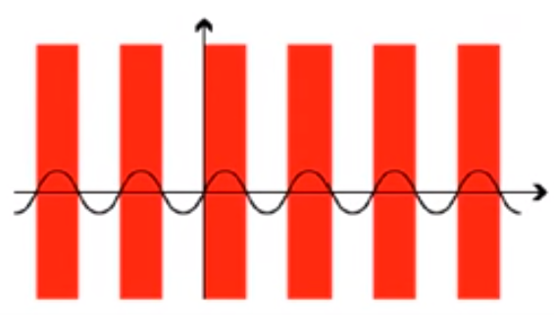
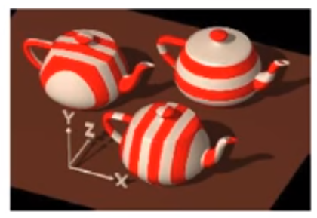
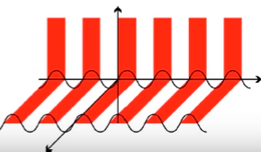
Space Filling Stripes
f(x, y, z) = color
float stripe(x, y, z) { return (sin x > 0 ? red : white); }
sin z
sin y

Slide 25
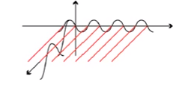
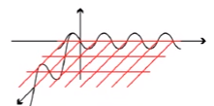
Space Filling Stripes
f(x, y, z) = color
float stripe(x, y, z) { return (sin x > 0 && sin y > 0 ? r : w); }
What to add to get a 3D checkerboard?

Slide 26
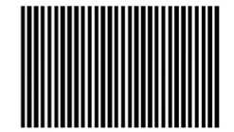

Space Filling Stripes
f(x, y, z) = color
A trigonometry trick to control the width
float stripe(x, y, z) { return (sin(π x / width) > 0? r : w); }
π 2π 3π

Slide 27
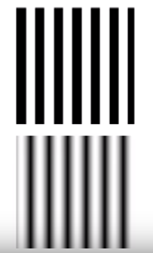
Space Filling Stripes
f(x, y, z) = smooth variation of 2+ colors
Use linear interpolation on colors to get this:
Something like: t = (1 + sin x ) / 2; color = (1-t)c0 + tc1

Slide 28
Space Filling Stripes
f(x, y, z) = color
Other alternating functions faster than sin?
float stripe(x, y, z) { return ((int)x % 2 == 0 ? r : w); }
How to set width to be W = 10?
float stripe(x, y, z) { return ((int)(x + W) % 2 == 0 ? r : w); }
or
float stripe(x, y, z) { return ((int) x % 2W in [0,W] ? r : w); }

Slide 29
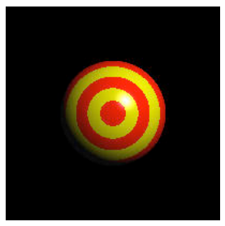
Space Filling Rings
f(x, y, z) = color
float stripe(x, y, z) { return ((int)r % 2 == 0 ? red : yel); } where r = sqrt(x² + y²)

Slide 30
Mipmapping
Consider three cases where
The polygon that is texture mapped is the same size (in screen space) as the texture image.
The polygon that is texture mapped is larger than the texture image. //viewer is close → magnify texture
The polygon that is texture mapped is smaller than the texture image. //viewer is far → minify texture

Slide 31
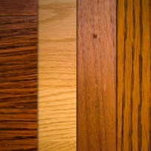
Mipmapping
Polygon same size as texture (map as usual):
texels pixels
Map
Result

Slide 32
Mipmapping
Polygon larger (texture needs to be magnified):
Map
Result

Slide 33
Mipmapping
Polygon smaller (texture needs to be minified):
Map
Result

Slide 34
Mipmapping
Minification: A change of 1 pixel in image space causes a change of >1pixel in texture space.
To avoid artifacts, one should use the average all texels that should fall on the same image pixel.
Map

Slide 35
Mipmapping
Take the extreme case: a 1 pixel change on image space corresponds to as many pixels as the width of the texture in texture space:
Reading the entire texture image to compute the average color is clearly inefficient in this case.
Map

Slide 36
Mipmapping
No such problem in magnification though
constant (4 pixels) lookup
Map
1 2
3 4
Result

Slide 37
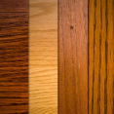

Mipmapping
Solution: Pre-filter images to create smaller resolution versions:
Then sample from the appropriate resolution in run-time.
Memory requirement – how much memory does a mipmap chain require?
A + A/4 + A/16 + A/64 + … = 4A/3

Slide 38
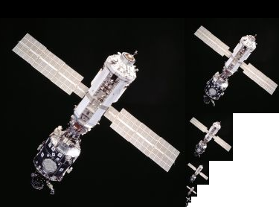
Mipmapping
Mipmaps are pre-calculated, optimized sequences of images, each of which is a progressively lower resolution representation of the same image
Mipmapping is mainly there for efficiency (minification)

Slide 39
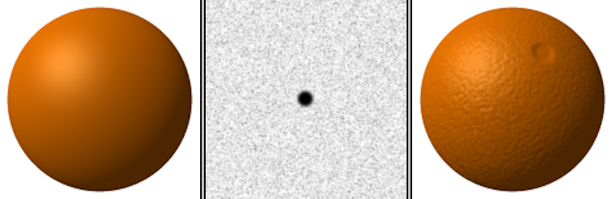
Bump Mapping
So far we used images of color for textures
Idea of having pre-calculated values and interpolating them over our object extends to different values
Colors → Vectors (normals)

Slide 40
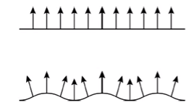
Bump Mapping
Idea: bumps cause slightly different reflections of light

Slide 41
Bump Mapping
Bump maps (array of vectors) are added to the normals

Slide 42
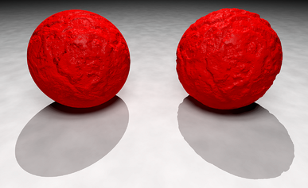
Displacement Mapping
Bump mapping is limited in that it does not modify the geometry (just alters the normals)
Displacement Mapping actually alters the geometry
Displacement maps (array of vectors) are added to the points
Note the unrealistic (bump) and realistic (displacement) shadows

Slide 43
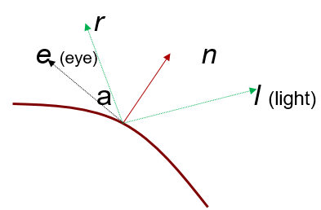
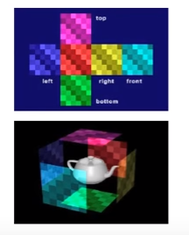
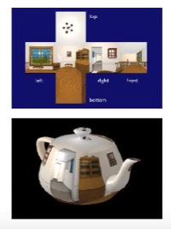
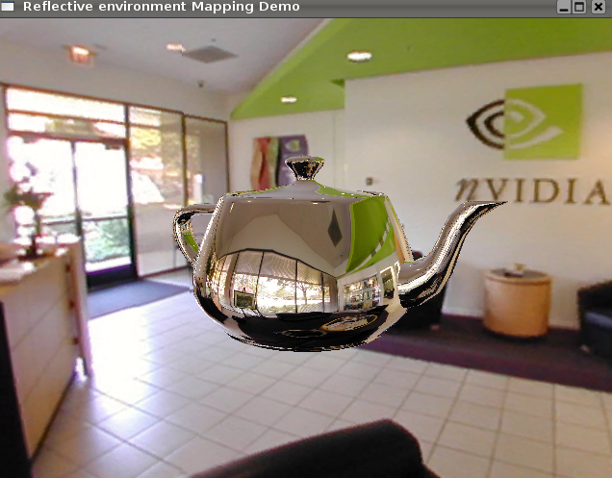
Environment Mapping
Aka Reflection Mapping
Place a cube around the object and project the environmnt of the obj onto the planes of the cube: our texture map
During rendering, compute reflection vector r and use that to lookup texture values from the cubic texture map

